Slide 1
RELATIVE VELOCITY AND ACCELERATION IN ONE AND TWO DIMENSIONS

Slide 2
RELATIVE VELOCITY
Relative velocity is defined as the velocity of an object B in the rest frame of another object A.
For example: A motorcycle travelling on the highway at a velocity of 120 km/h passes a car travelling at a velocity of 90 km/h.

Slide 3
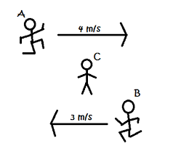
Representation of relative velocity of two persons w.r.t stationary person

Slide 4
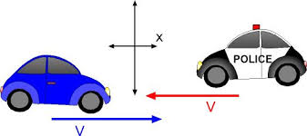
Representation of relative velocity of two cars in reference to x-axis

Slide 5
Can Relative velocity be negative?
Relative velocity can be negative. As relative velocity is the difference between two velocities irrespective of the magnitude of the velocities, it can be negative.

Slide 6
What is difference between velocity and relative velocity?
The difference between velocity and relative velocity is that velocity is measured with respect to a reference point which is relative to a different point. While relative velocity is measured in a frame where an object is either at rest or moving with respect to absolute frame.

Slide 7
What is the need of using relative velocity?
The need for using relative velocity is that it is used for differentiating if the object is at rest or moving.

Slide 8
What is relative velocity formula?
The relative velocity is the velocity that the body A would appear to an observer on the body B and vice versa.
Mathematically, the relative velocity is the vector difference between the velocities of two bodies.
i.e., Relative velocity = velocity of the body A – velocity of the body B.
The equation is:
v_{AB} = v_{A} – v_{B}.

Slide 9
What is the SI unit of relative velocity?
The SI unit of relative velocity is Meter per second(m$s^{−1}$).

Slide 10
What is relative velocity example?
We encounter occasions where one or more objects move in a frame which is non-stationary with respect to another observer.
For example, a boat crosses a river that is flowing at some rate or an aeroplane encountering wind during its motion.

Slide 11
When relative velocity is zero?
The relative velocity can be zero. It is absolutely possible because when two bodies move with equal velocity in the same direction, then they have zero relative velocity.

Slide 12
RELATIVE ACCELERATION
Acceleration is the change in an object’s velocity in a specific period of time.
Relative acceleration is the comparison of the acceleration of two bodies or for a rigid body, the acceleration of a point on a rigid body in reference to another point on it.

Slide 13
Formula and Unit for relative acceleration
The equation for relative acceleration is given by:
$a_{PS}$ = $a_{PS"}$+ $a_{S"S}$
The unit for relative acceleration is meter per squared second (m$s^{−2}$).

Slide 14
RELATIVE VELOCITY AND ACCELERATION IN ONE DIMENSION
Motion does not happen in isolation.
If you’re riding in a train moving at 10 m/s east, this velocity is measured relative to the ground on which you’re traveling. However, if another train passes you at 15 m/s east, your velocity relative to this other train is different from your velocity relative to the ground.
Your velocity relative to the other train is 5 m/s west.

Slide 15
Reference Frames
To discuss relative motion in one or more dimensions, we first introduce the concept of reference frames.
When we say an object has a certain velocity, we must state it has a velocity with respect to a given reference frame.
In most examples we have examined this reference frame has been Earth. If you say a person is sitting in a train moving at 10 m/s east, then you imply the person on the train is moving relative to the surface of Earth at this velocity, and Earth is the reference frame.
We can expand our view of the motion of the person on the train and say Earth is spinning in its orbit around the Sun. In this case, the solar system is the reference frame.
In short, all discussion of relative motion must define the reference frames involved.

Slide 16
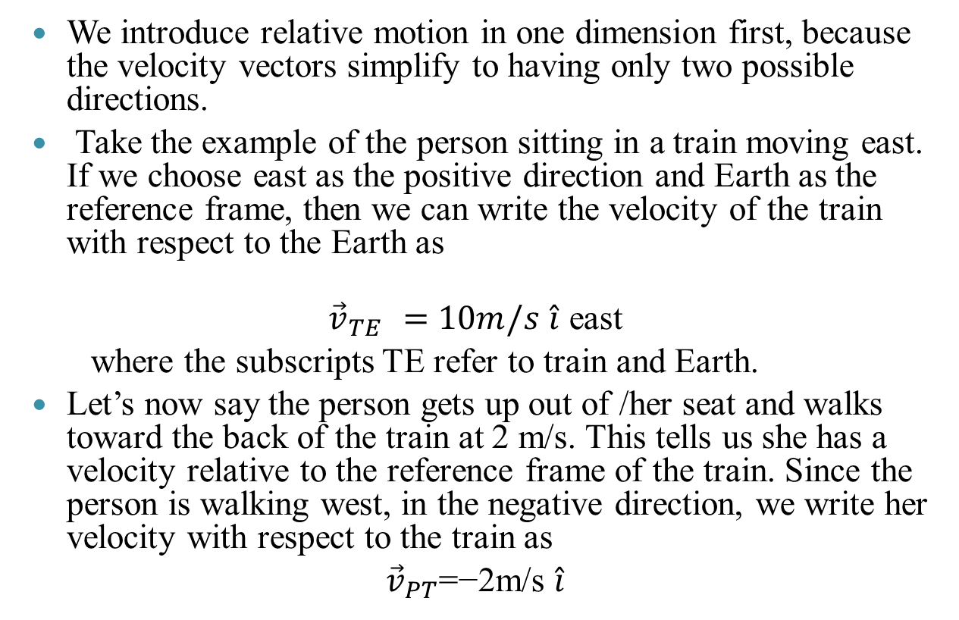
Relative Motion in One Dimension
We introduce relative motion in one dimension first, because the velocity vectors simplify to having only two possible directions.
Take the example of the person sitting in a train moving east. If we choose east as the positive direction and Earth as the reference frame, then we can write the velocity of the train with respect to the Earth as
${\vec{v}}_{TE }=10m/s$ $\hat{i}$ east
where the subscripts TE refer to train and Earth.
Let’s now say the person gets up out of /her seat and walks toward the back of the train at 2 m/s. This tells us she has a velocity relative to the reference frame of the train. Since the person is walking west, in the negative direction, we write her velocity with respect to the train as
${\vec{v}}_{PT}$=−2m/s $\hat{i}$

Slide 17
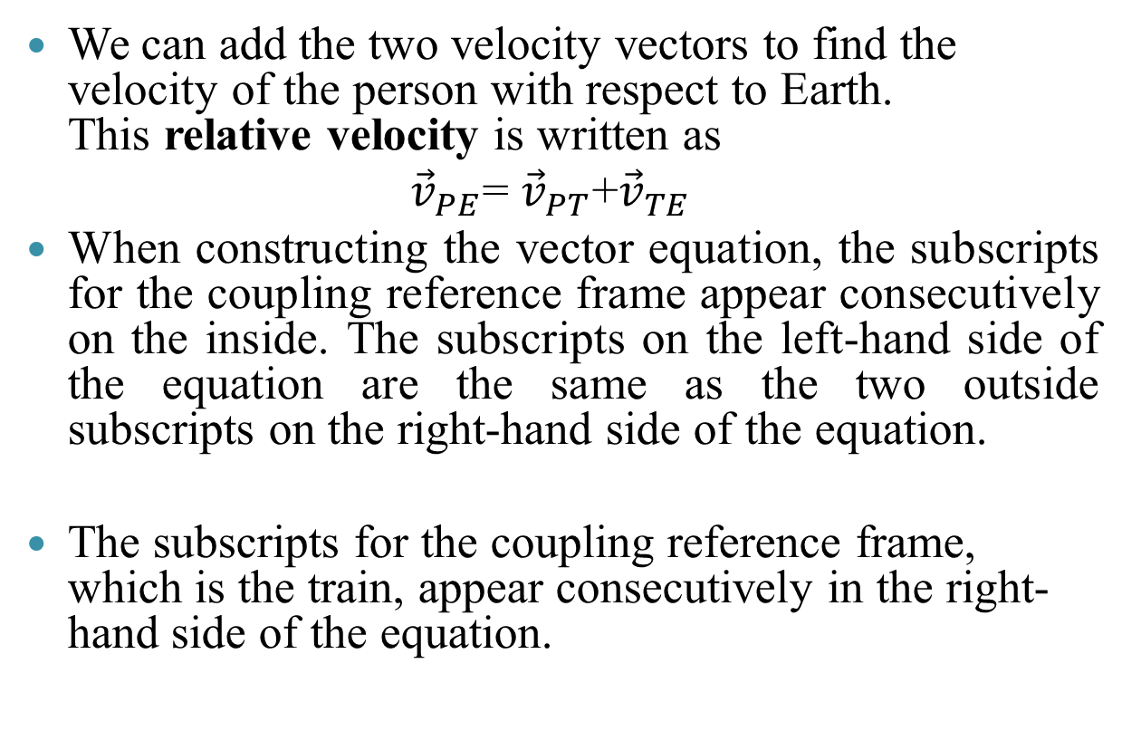
Cont..
We can add the two velocity vectors to find the velocity of the person with respect to Earth. This relative velocity is written as
${\vec{v}}_{PE}$= ${\vec{v}}_{PT}$+${\vec{v}}_{TE}$
When constructing the vector equation, the subscripts for the coupling reference frame appear consecutively on the inside. The subscripts on the left-hand side of the equation are the same as the two outside subscripts on the right-hand side of the equation.
The subscripts for the coupling reference frame, which is the train, appear consecutively in the right-hand side of the equation.

Slide 18
Cont..
Adding the vectors, we find
${\vec{v}}_{PE}=8m/s$ $\hat{i}$
So the person is moving 8 m/s east with respect to Earth.

Slide 19
Velocity vectors of the train with respect to Earth, person with respect to the train, and person with respect to Earth.

Slide 20
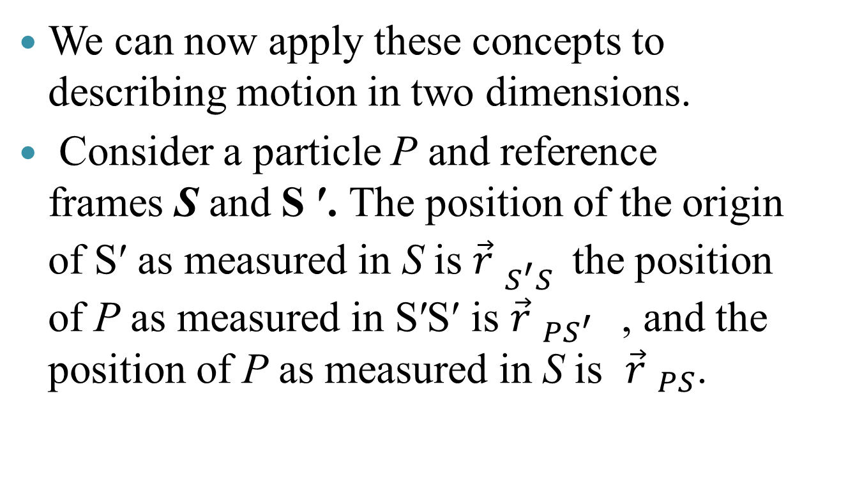
Relative Velocity in Two Dimensions
We can now apply these concepts to describing motion in two dimensions.
Consider a particle P and reference frames S and S ′. The position of the origin of S′ as measured in S is ${\vec{r} }_{S^{′}S }$ the position of P as measured in S′S′ is ${\vec{r} }_{{PS}^{′} }$ , and the position of P as measured in S is ${\vec{r} }_{PS}$.

Slide 21
Representation of position of the particle

Slide 22
Cont..
From figure, we see that
${\vec{r} }_{PS}$= ${\vec{r} }_{{PS}^{′}}$+ ${\vec{r} }_{S^{′}S }$

Slide 23
Relative velocities
The relative velocities are the time derivatives of the position vectors. Therefore,
${\vec{v} }_{PS}$=${\vec{v} }_{{PS}^{′}}$+ ${\vec{v} }_{S^{′}S }$
The velocity of a particle relative to S is equal to its velocity relative to S′S′ plus the velocity of S′S′ relative to S.

Slide 24
For number of reference frames
We can extend it to any number of reference frames.
For particle P with velocities ${\vec{v} }_{PA }$, ${\vec{v} }_{PB }$and ${\vec{v} }_{PC }$in frames A, B, and C,
${\vec{v} }_{PC }$= ${\vec{v} }_{PA }$+ ${\vec{v} }_{\begin{aligned}AB \\ \end{aligned}}$

Slide 25
Relative Acceleration
We can also see how the accelerations are related as observed in two reference frames by differentiating
${\vec{a} }_{PS}$=${\vec{a} }_{{PS}^{′}}$+ ${\vec{a} }_{S^{′}S }$
We see that if the velocity of S′S′ relative to S is a constant, then
${\vec{a} }_{S^{′}S }$= 0 and
${\vec{a} }_{PS}$=${\vec{a} }_{{PS}^{′}}$
This says the acceleration of a particle is the same as measured by two observers moving at a constant velocity relative to each other.

